Slide 1
RISE@Work
Final Presentation

Slide 2
Final Deliverable to Client:
All project code
.zip file
Access to online repository
Access to Google Drive folder
Documentation
Hard copy
Electronic copy
Will be delivered on April 17
Notes:
Negin

Slide 3
What we have completed

Slide 4
Maps
Notes:
Aaron

Slide 5
Maps: The Request
“As a researcher, I can decide which maps are visible to participants in my organization by selecting and deselecting them.”
Notes:
Aaron

Slide 6
Maps: The Solution
Research administrators are now able to add and delete maps for only their organizations.
Research administrators can clone existing maps for their organizations.
Maps are no longer static pictures, but interactive Google Maps.
Notes:
Aaron

Slide 7
Maps
Demo

Slide 8
Consent Forms
Notes:
Sam/Nik

Slide 9
Consent Forms: The Request
“As a researcher, I can edit my organization’s consent form and contact details.”
Notes:
Sam/Nik

Slide 10
Consent Forms: The Solution
Researchers are now able to upload their own custom PDF consent forms.
When a user registers, the consent form for the desired organization is displayed.
Checkbox to agree to provide consent only appears after consent form is visible.
Notes:
Sam/Nik

Slide 11
Consent Forms
Demo
Notes:
Sam/Nik

Slide 12
Downloadable Spreadsheet Data
Notes:
Zack

Slide 13
Improved Spreadsheets: The Request
“As a researcher, I can download all survey data in a well-formatted excel spreadsheet.”
Notes:
Zack

Slide 14
Improved Spreadsheets: The Solution
An organization’s spreadsheet data can now be downloaded in a more readable format.
Much more data is included.
Notes:
Zack

Slide 15
Improved Spreadsheets
Demo

Slide 16
Surveys
Notes:
Nik

Slide 17
Improved Surveys: The Problem
Surveys could not be edited
Organizations were forced to use the same survey
User experience was very poor
Researchers were forced to take the surveys to access the site

Slide 18
Improved Surveys: The Solution
Surveys are now easily manageable
Surveys are ignored for researchers
Survey interface completely redesigned
Researchers control surveys for their organizations

Slide 19
Improved Surveys
Demo

Slide 20
Administrative Dashboard
Notes:
Nik

Slide 21
Administrative Dashboard: The Problem
Admins and researchers used same page as participants, but none of the functionality worked
Admin functions were hidden, sometimes not appearing at all
Admins had no super-organizational privileges

Slide 22
Administrative Dashboard: The Solution
Admins and researchers now have specialized dashboards
Functionality is now reliable and easy-to-use
Better separation of privileges for researchers
Admins can now manage across organizations

Slide 23
Administrative Dashboard
Demo

Slide 24
Documentation
Notes:
Negin

Slide 25
Documentation
Future developers will benefit from well-documented code
Final documentation PDF covers an overview of the site, instructions (Map Creation, Surveys..)
Will exist in Google Drive along with other important documents
Notes:
Negin

Slide 26
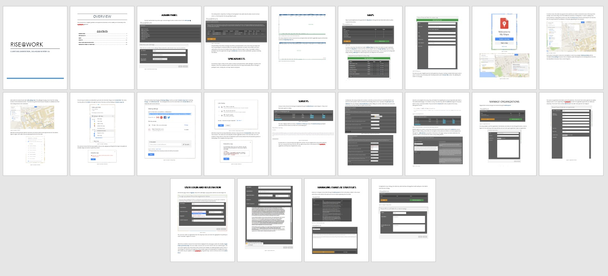
Documentation: Preview

Slide 27
Emails
Notes:
Bray

Slide 28
Automatic Emails: The Request
“As a researcher, I can send and receive emails to and from program participants in my organization.”

Slide 29
Automatic Emails: The Solution
Email content can be viewed and edited by administrators (Michelle and Dan)
Sending emails automatically hit an unforeseen snag:
Need show ownership of dal.ca domain (not accessible by students)
Could also purchase alternate domain (~10/year) e.g. riseatwork.ca
All set up to work (as seen in last demo), just need correct access to domain name.

Slide 30
Accelerated Testing
Notes:
Sam

Slide 31
Accelerated Testing: The Ask
“As a site administrator, I can test that the program works by using temporary, artificial user data to see if emails are properly sent, phases can be completed, the proper information is tracked, and that all user interactions and expected uses are functional.”

Slide 32
Accelerated Testing: The Solution
Manual tests that check that RISE@Work functions correctly (seconds)
Tests can be run in a test database separate from real user data (will not interfere with real data).
For developers
Pilot testing mode (hours/days)
Shorten the length of Phases to days/hours instead of weeks.
For the client

Slide 33
Accelerated Testing: The Result
Not complete as of this Demo.
We have a solution, just needs to be implemented.

Slide 34
Recommendations for Future Work

Slide 35
Recommendations for Future Work
Front-end overhaul
Redesign website
Performance issue
Lots of little tweaks
Performance issues
User experience issues
Stars/points
Deployment
Another semester of students or single seasoned developer could implement the remaining major changes

Slide 36
Questions?

